Slide 1
Superscalar & Superpipelined Processor
P. K. Roy
Asst. Professor
Siliguri Institute of Technology

Slide 2
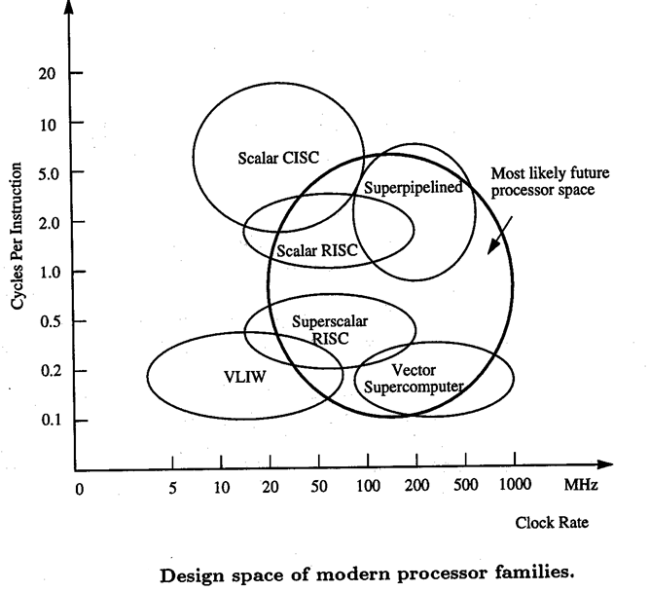
Modern Processor Families

Slide 3
Scalar Processor
Single Instruction Stream Single Data stream.
A CPU that performs computations on one number or set of
data at a time, typically integers or floating point numbers.
Can take up some time.
Only one instruction is issued per cycle, and only one completion of instruction is expected from the pipeline per cycle.
Has a one-cycle latency for a simple operation.
Has a one-cycle Latency between instruction issues.

Slide 4
Superscalar Processor
1st invented in 1987.
Superscalar processing is the ability to initiate multiple instructions during the same clock cycle.
A superscalar machine is able to execute multiple instructions independently and concurrently in multiple pipelines.
Superscalar architecture exploit the potential of ILP (Instruction Level Parallelism).
Applicable to both RISC & CISC, but usually in RISC.
A superscalar processor typically fetches multiple instructions at a time and then attempts to find nearby instructions that are independent of one another and can therefore be executed in parallel. If the input to one instruction depends on the output of a preceding instruction, then the latter instruction cannot complete execution at the same time or before the former instruction.
Superscalar performs only one pipeline stage per clock cycle in each parallel pipeline.
The effective CPI of a superscalar processor should be less than that of a generic scalar RISC processor.
Clock rates of scalar RISC and superscalar RISC machines are similar.

Slide 5
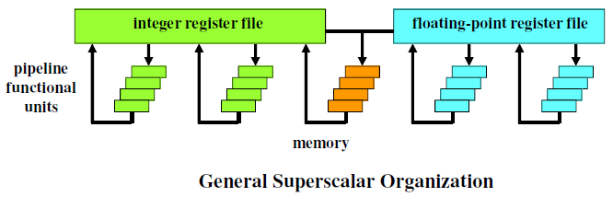
Superscalar Processor
Supports the parallel execution of two integer operations, two floating point operations and one memory operation.

Slide 6
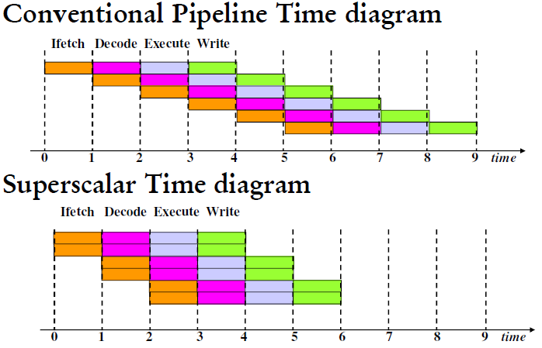
Superscalar Execution
Degree = number of pipelines (e.g., degree 2 superscalar pipeline=> two pipelines)

Slide 7
Limitations of superscalar
The superscalar approach depends on the ability to execute multiple instructions in parallel. The term Instruction-level parallelism refers to the degree to which the instructions of a program can be executed in parallel. A combination of compiler-based optimization and hardware techniques can be used to maximize instruction-level parallelism.

Slide 8
Superpipelined Processor
1st invented in 1988.
Result from the observation that a large number of pipeline
operations do not require a full clock cycle to complete.
Many pipeline stages need less than half a clock cycle.
Super-pipelining is the breaking of stages of a given pipeline into smaller stages (thus making the pipeline deeper) in an attempt to shorten the clock period and thus enhancing the instruction throughput by keeping more and more instructions in flight at a time.
Super-pipeline system is capable of performing two pipeline stages per clock cycle.

Slide 9
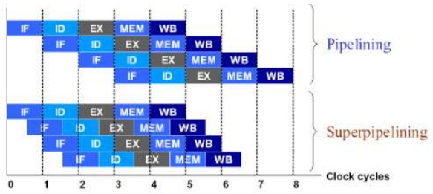
Superpipelined Processor
Degree 2

Slide 10
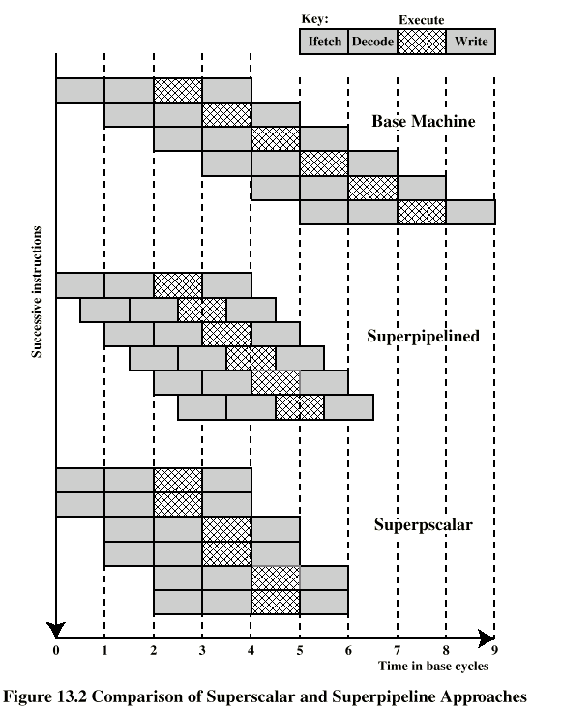
Superscalar v Superpipeline
Degree 2
Issue 2

Slide 11
Super pipeline benefit & drawback
Benefits: The major benefit of super-pipelining is the increase in the number of instructions which can be in the pipeline at one time and hence the level of parallelism.
Drawbacks: The larger number of instructions "in flight" (i.e., in some part of the pipeline) at any time, increases the potential for data dependencies to introduce stalls.

Slide 12


Superscalar Performance
Let ,
No. of independent instructions through the pipeline = N
No. of stages in a pipeline = K
Therefore,
Time required by the scalar base m/c = K + N -1
The ideal time required by an m-issue superscalar m/c = K +
Where,
K = Time to execute 1st m instruction through the m pipelines
simultaneously
= Time to execute remaining (N – m) instructions, m per cycle,
through m pipelines.
Speedup =
As N→ ∞ , speedup → m

Slide 13


Superpipeline Performance
In a superpipelined processor of degree n, the pipeline cycle
time is 1/n of the base cycle. As a comparison, while a fixed
point add takes 1 cycle in the base scalar processor, the same
operation takes n short cycles in a superpipelined processor
implemented with the same technology.
Therefore,
The min. time required to execute N instructions for a
superpipelined m/c of degree n with K stages in the pipeline is
As N→ ∞ , speedup → n
Speedup =

Slide 14
Superscalar-Superpipelined Processor
Combination of both approaches.
e.g. Digital Equipments Alpha Processor & MIPS R4000 Processor
The m/c executes m instructions every cycle with a pipeline cycle 1/n of the base cycle. Thus the degree of (m,n).
Simple operation Latency is n pipeline cycles.
The level of parallelism to fully utilize this m/c is mn instructions.
***Self Review: DEC Alpha Processor & MIPS R4000 From Kai Hwang

Slide 15
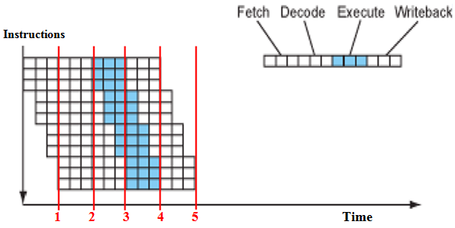
Superscalar-Superpipelined Processor
Degree (3,3)

Slide 16


Superscalar-Superpipeline Performance
Min. time required to execute N independent instructions n on a
superscalar-superpipelined m/c of degtree (m,n) is –
Therefore,
Speedup =
As N→ ∞ , speedup → mn

Slide 17
Hurdles in Superscalar
Limited by
True data dependency
Procedural dependency
Resource conflicts
Output dependency
Antidependency

Slide 18
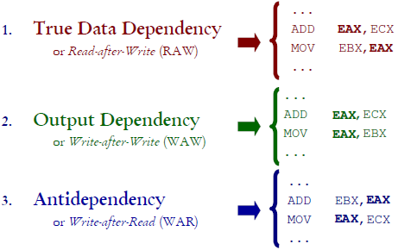
Data Dependency

Slide 19
Procedural Dependency
Can not execute instructions after a branch in parallel with instructions before a branch
Also, if instruction length is not fixed, instructions have to be decoded to find out how many fetches are needed
This prevents simultaneous fetches

Slide 20
Resource Conflict
Two or more instructions requiring access to the same resource at the same time
e.g. two arithmetic instructions
Can duplicate resources
e.g. have two arithmetic units

Slide 21
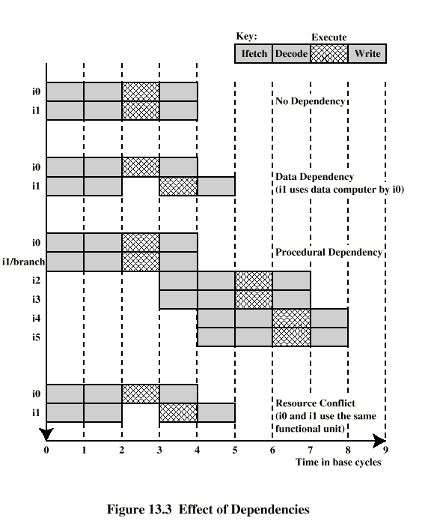
Effect of Dependencies

Slide 22
Design Issues
A typical superscalar will have
multiple instruction pipelines
an instruction cache that can provide multiple instructions per fetch
multiple buses among the functional units
Instruction level parallelism
– Instructions in a sequence are independent
– Execution can be overlapped
– Governed by data and procedural dependency
• Machine Parallelism
– Ability to take advantage of instruction level parallelism
– Governed by number of parallel pipelines & by ability to find
independent instructions

Slide 23
Superscalar Hardware Support
Facilities to simultaneously fetch multiple instructions
Logic to determine true dependencies involving register values and Mechanisms to communicate these values
Mechanisms to initiate multiple instructions in parallel
Resources for parallel execution of multiple instructions
Mechanisms for committing process state in correct order

Slide 24
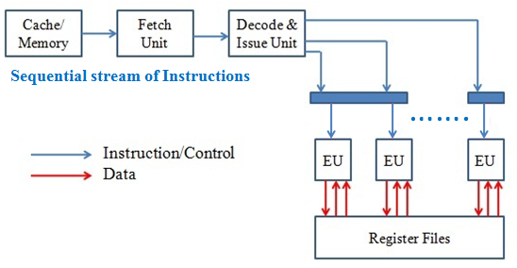
Superscalar Architecture (1)

Slide 25
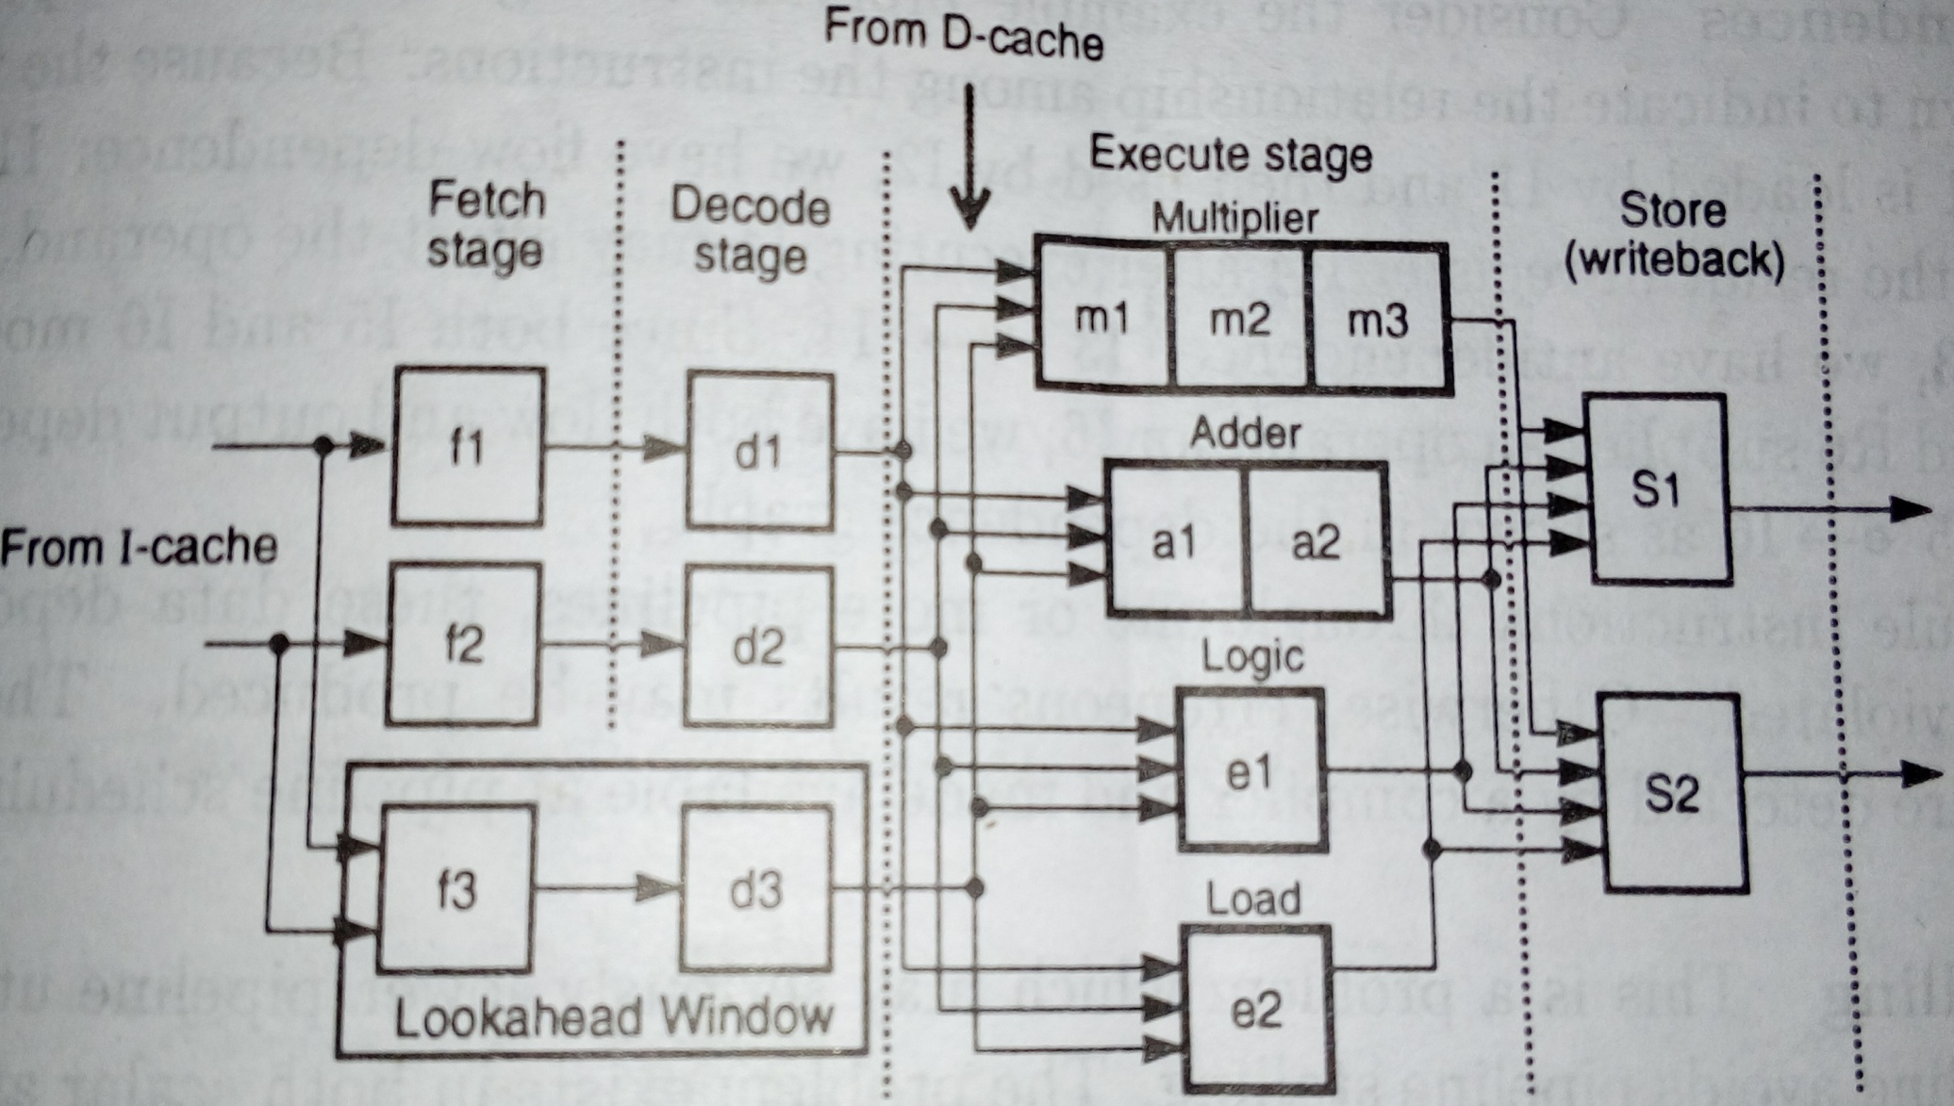
Superscalar Architecture (2)
A dual-pipeline superscalar processor with 4 functional units in the execution
stage & a lookahead window producing out-of-order issues

Slide 26
Instruction Issue Policy
Instruction fetch: order in which instructions are fetched
Instruction execution: order in which instructions are delivered to a functional unit to execute the operation
Instruction commit: order in which instruction results are stored in registers and memory
Three categories of issue policies -
- In-order issue with in-order completion
- In-order issue with out-of-order completion
- Out-of-order issue with out-of-order completion

Slide 27
In-Order Issue In-Order Completion
Issue instructions in the order they occur and write results in same order
May fetch more than1 instructions
Not very efficient – Instructions may stall if:
– "Partnered" instruction requires more time
– "Partnered" instruction requires same resource
Instructions must stall if necessary due to resource conflicts,
procedural or any data dependencies.
Forced order of output
Easy to implement but rarely used in scalar processors due to some unnecessary delays to maintain instruction order.
Still used in multiprocessor environment.

Slide 28
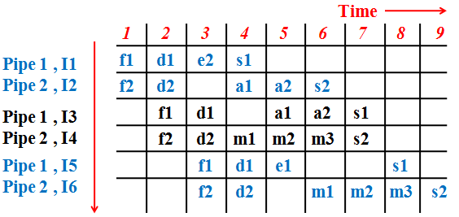
In-Order Issue In-Order Completion
I1: Ld R1, A
I2: Add R2, R1
I3: Add R3, R4
I4: Mul R4, R5
I5: Comp R6
I6: Mul R6, R7
In-Order Issue with In-Order completion in 9 cycles

Slide 29
In-Order Issue Out-of-Order Completion
Independent instructions are allowed to complete out-of-order.
Improved pipeline utilization rate.
Output dependency
R3:= R3 + R5; (I1)
R4:= R3 + 1; (I2)
R3:= R5 + 1; (I3)
I2 depends on result of I1 - data dependency
If I3 completes before I1, the result from I1 will be wrong - output (read-write) dependency
Output dependency makes instruction issue logic more complex.
Forced order of input.
Found in both scalar & superscalar processors.

Slide 30
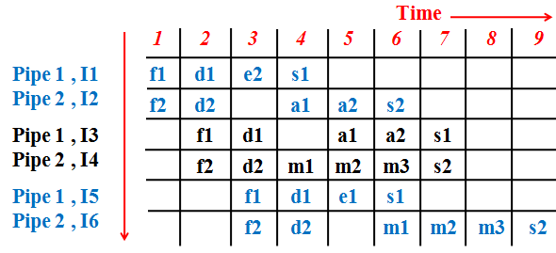
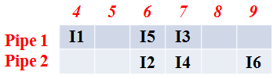
In-Order Issue Out-of-Order Completion
I1: Ld R1, A
I2: Add R2, R1
I3: Add R3, R4
I4: Mul R4, R5
I5: Comp R6
I6: Mul R6, R7
Completion order

Slide 31
Out-of-Order Issue Out-of-Order Completion
Use of lookahead window (sometimes called instruction window or buffer) with its own fetch & decode logic.
Can continue to fetch and decode until this buffer is full
When a functional unit becomes available, an instruction is
assigned to that pipe to be executed provided:
– it needs that particular functional unit
– no conflicts or dependencies are currently blocking its
execution
Since instructions have been decoded, processor can lookahead in hopes of identifying independent instructions (reordering).
Provides optimized pipeline execution.
Extra cost for lookahead window .

Slide 32
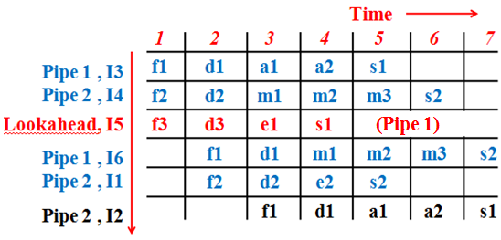
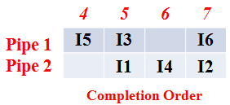
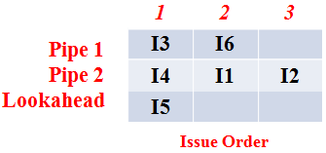
Out-of-Order Issue Out-of-Order Completion
I1: Ld R1, A
I2: Add R2, R1
I3: Add R3, R4
I4: Mul R4, R5
I5: Comp R6
I6: Mul R6, R7

Slide 33
Exercise
Consider the following code segment
1. R3=R0*R1
2. R4=R0+R2
3. R5=R0/R1
4. R6=R1+R4
5. R7=R1*R2
6. R1=R0-R2
7. R3=R3*R1
8. R1=R4+R4
Perform: 1. In-order issue with in-order completion
2. In-order issue with out-of-order completion
3. Out-of-order issue with out-of-order completion

Slide 34
Antidependency
Allowing for rearranged entrance to execution unit may result in Antidependency.
Called Anitdependency because it is the exact opposite of data dependency
Data dependency: I2 depends on data from I1.
Antidependency: I1 depends on data that could be destroyed by I2.
Example:
I1: R3 = R3 + R5
I2: R4 = R3 + 1
I3: R3 = R5 + 1
I4: R7 = R3 + R4
I3 can not complete before I2 starts as I2 needs a value in R3 and I3 changes R3.

Slide 35
Register Renaming
Output and antidependencies occur because register contents may not reflect the correct ordering from the program
May result in a pipeline stall
Registers allocated dynamically
- i.e. registers are not specifically named
These problems are storage conflicts – multiple instructions competing for use of same register.
Solution: duplicate resources
Assigning a value to a register dynamically creates new register
Subsequent reads to that register must go through renaming process

Slide 36
Register Renaming example
I1: R3b = R3a + R5a
I2: R4b = R3b + 1
I3: R3c = R5a + 1
I4: R7b = R3c + R4b
Without subscript refers to logical register in instruction
With subscript is hardware register allocated

Slide 37
Exercise
I1: R7 = R3 + R4
I2: R3 = R7
I3: R7 = R7 + 1
I4: R4 = R5
I5: R3 = R7 + R3
I6: R5 = R4 + R3
Solve the antidependency using Register Renaming.

Slide 38

References
PPT on Pipelining from CS303 (3rd Semester)
Advanced Computer Architecture – Kai Hwang
Advanced Computer Architectures – Dezso Sima, Peter Karsuk
Computer Organization – Carl Hamacher
Computer Architecture & Organization – John P. Hayes
Computer System Architecture – M. Morris Mano
Computer Organization & Architecture – T. K. Ghosh
Computer Organization & Architecture – Xpress Learning

